Slide 1
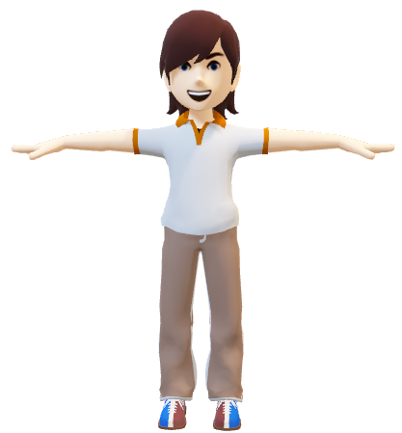
“Integrating YOLOv8 and Media-Pipe for Accurate Pose Detection and Replication in Unity 3D Environments”
Raja Ali Akhtar BSCE21035

Slide 2
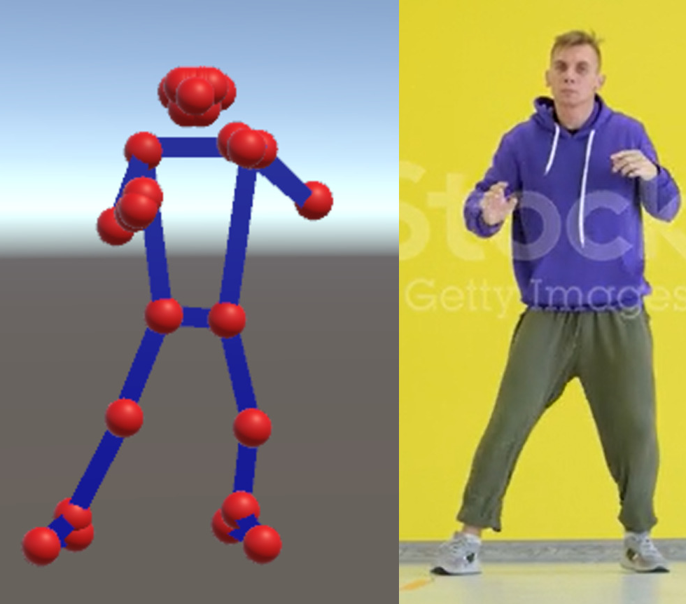
Abstract
This research addresses the challenge in virtual character animation: seamless motion replication by recording human movements.
Fine-tuning YOLOv8 for real-time pose detection using a custom dataset.
Comparative analysis of fine-tuned YOLOv8 and pretrained MediaPipe model in OpenCV for pose detection.
Integration with Unity 3D for automatic motion replication.
Applications: virtual reality experiences, gaming, motion capture.

Slide 3
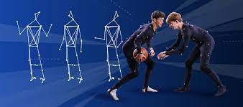
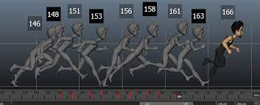
Introduction
Advancements in computer vision and VR have heightened interest in automating 3D character animation.
Traditional approaches (manual keyframing, motion capture setups) are time-consuming and costly.
This research introduces a deep learning-based method for real-time posture identification and replication.
Objectives: Fine-tune YOLOv8, compare with MediaPipe, integrate into Unity 3D for seamless animation.

Slide 4

Related Work
Markerless Motion Capture: Extracting human motion without markers/sensors.
Pose Estimation and Tracking: Estimating 2D/3D human poses and tracking motion.
Motion Retargeting and Synthesis: Transferring motion between characters/generating new sequences.
Deep Learning for Motion Generation: Learning and generating realistic motion patterns.
Applications in Animation and VR: Enhancing animation, VR, and gaming experiences.
Evaluation Metrics and Benchmarks: Assessing pose accuracy, temporal coherence, realism.

Slide 5
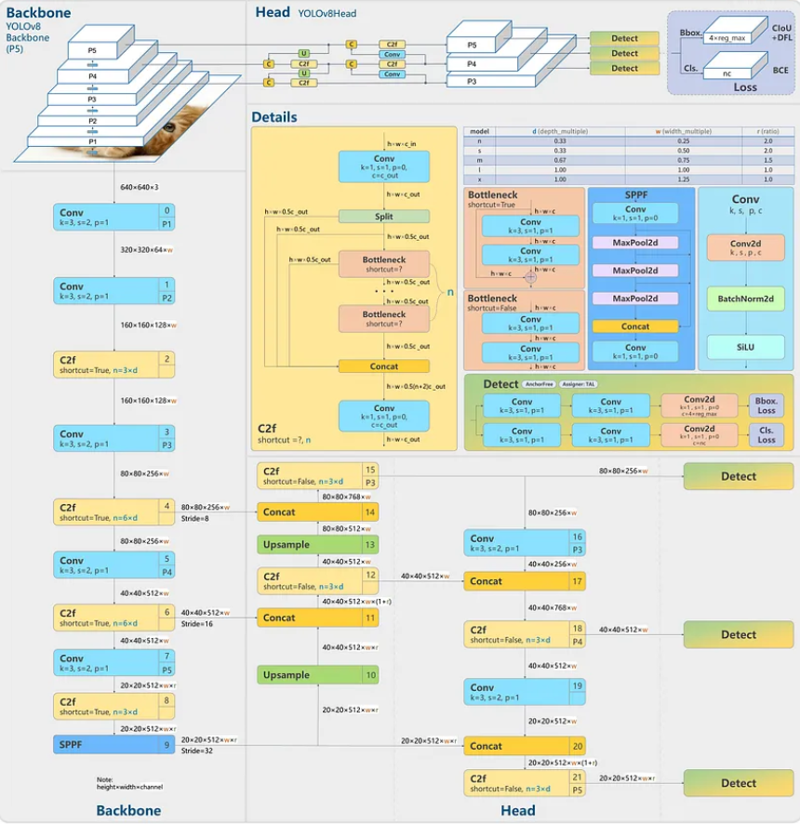
System Architecture
Backbone
CSPDarknet53: 53 convolutional layers
Enhances information flow with cross-stage partial connections
Neck
Merges feature maps
Uses Spatial Pyramid Pooling (SPP) and Path Aggregation Network (PAN)
Head
Generates final predictions
Multiple convolutional and fully-connected layers
Detects objects at various scales

Slide 6
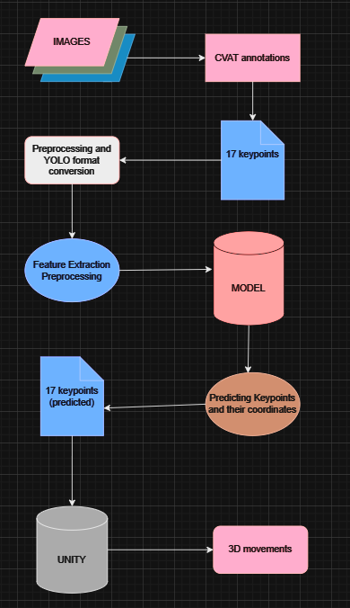
Process flow
Data Collection
Annotation
Preprocessing and Format Conversion
Feature Extraction and Preprocessing
Model Training
Prediction
Integration with Unity

Slide 7
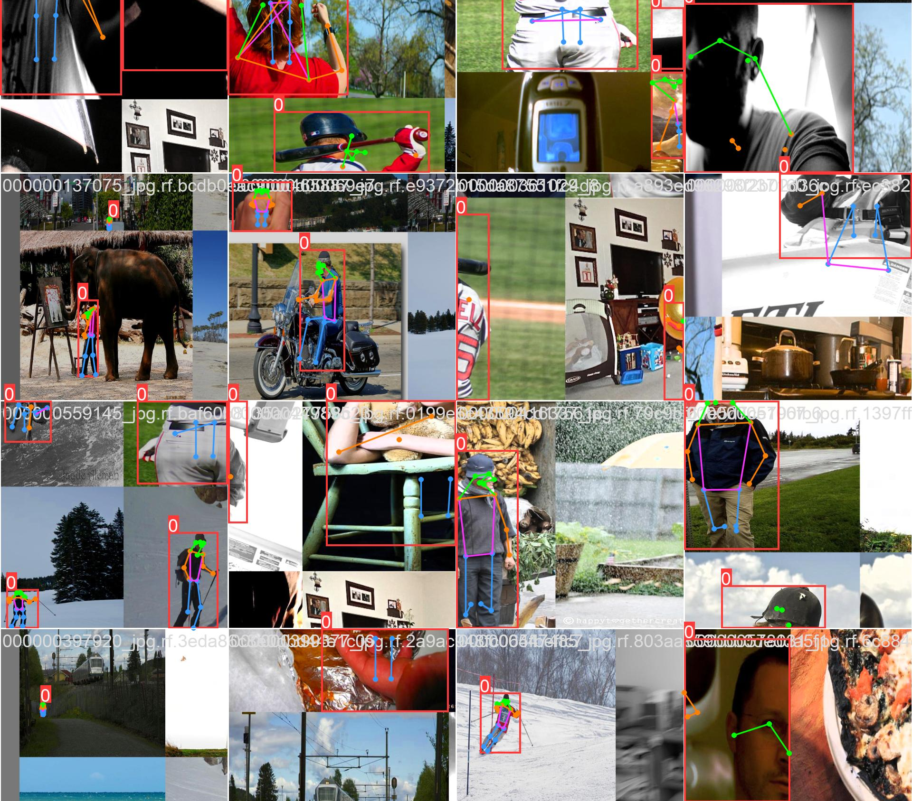
Data Collection
Custom dataset combining COCO 2017 and OChuman datasets.
Approximately 3000 images with single subjects in various poses.

Slide 8
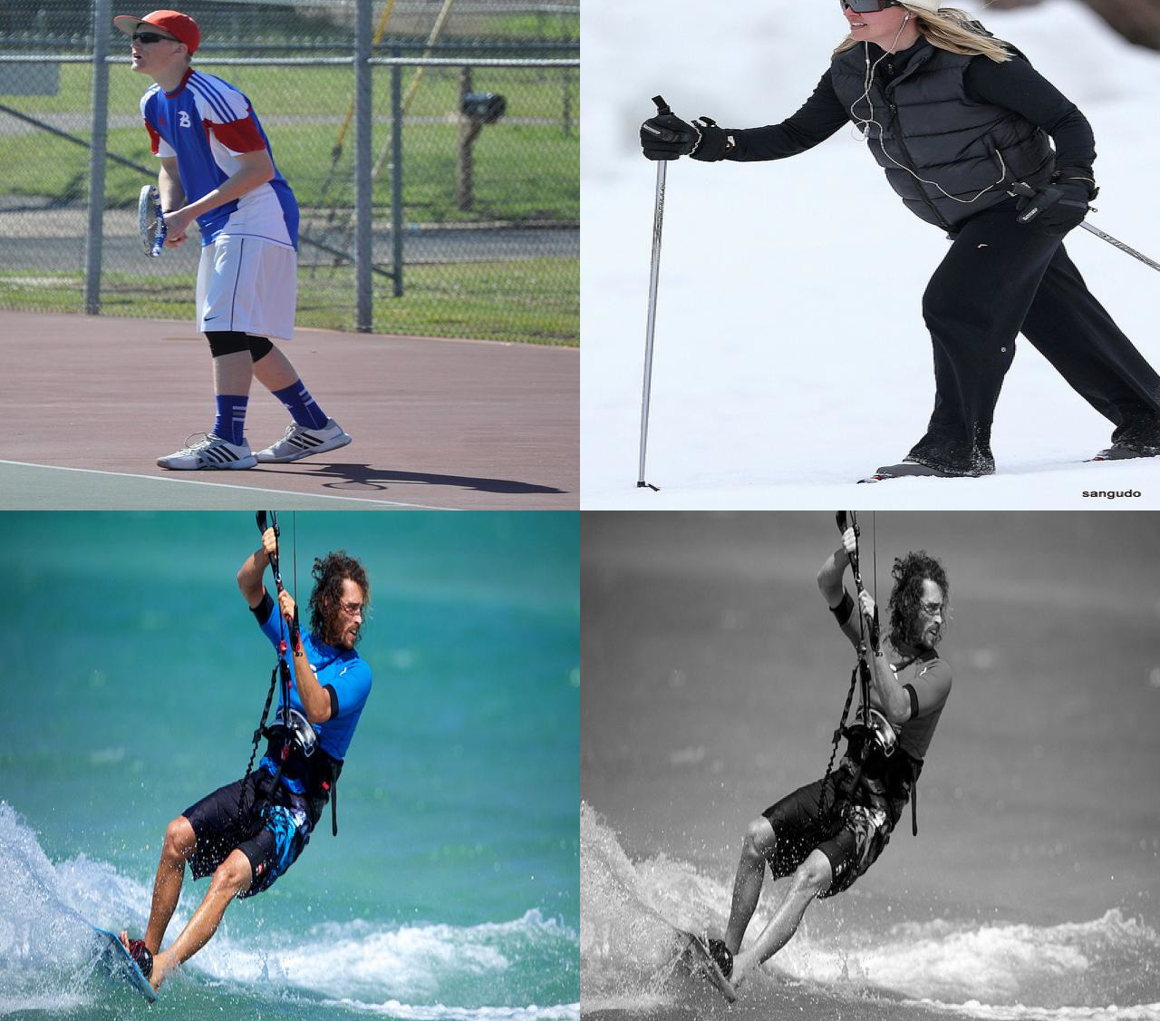
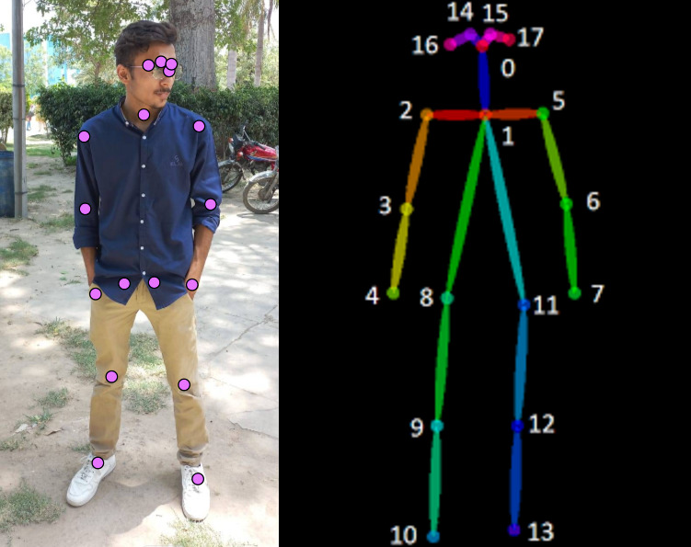
Data Annotation and Preprocessing
Manual annotation using Computer Vision Annotation Tool.
Preprocessing with RoboFlow: orientation correction, resizing to 640x640, contrast adjustment.
Augmentation: 10% of training dataset augmented with grayscale and flipped images.
Dataset split: 70% training, 15% validation, 15% testing.

Slide 9
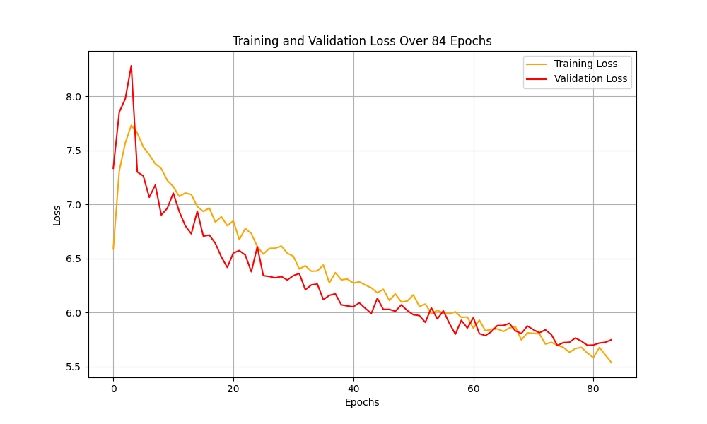
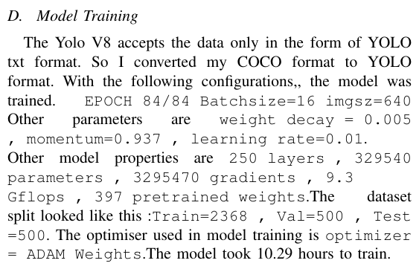
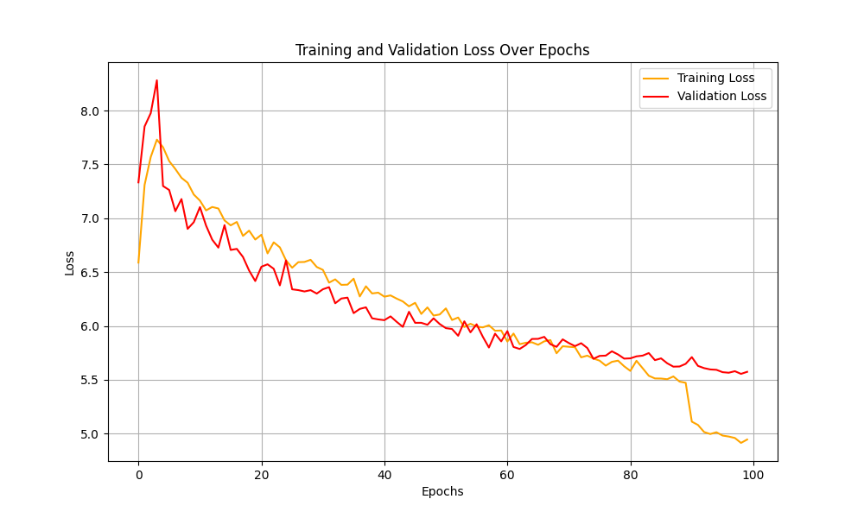
Model Training

Slide 10
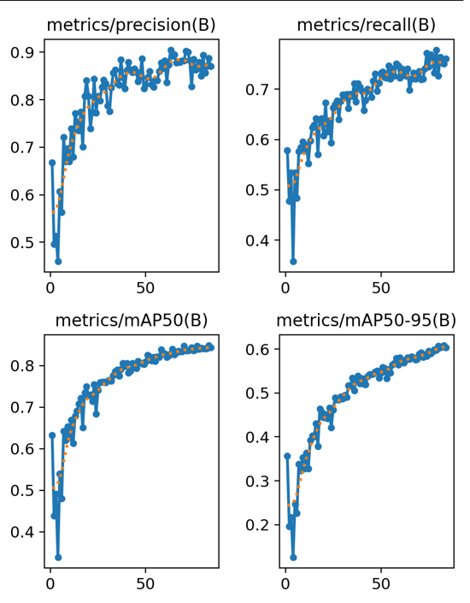
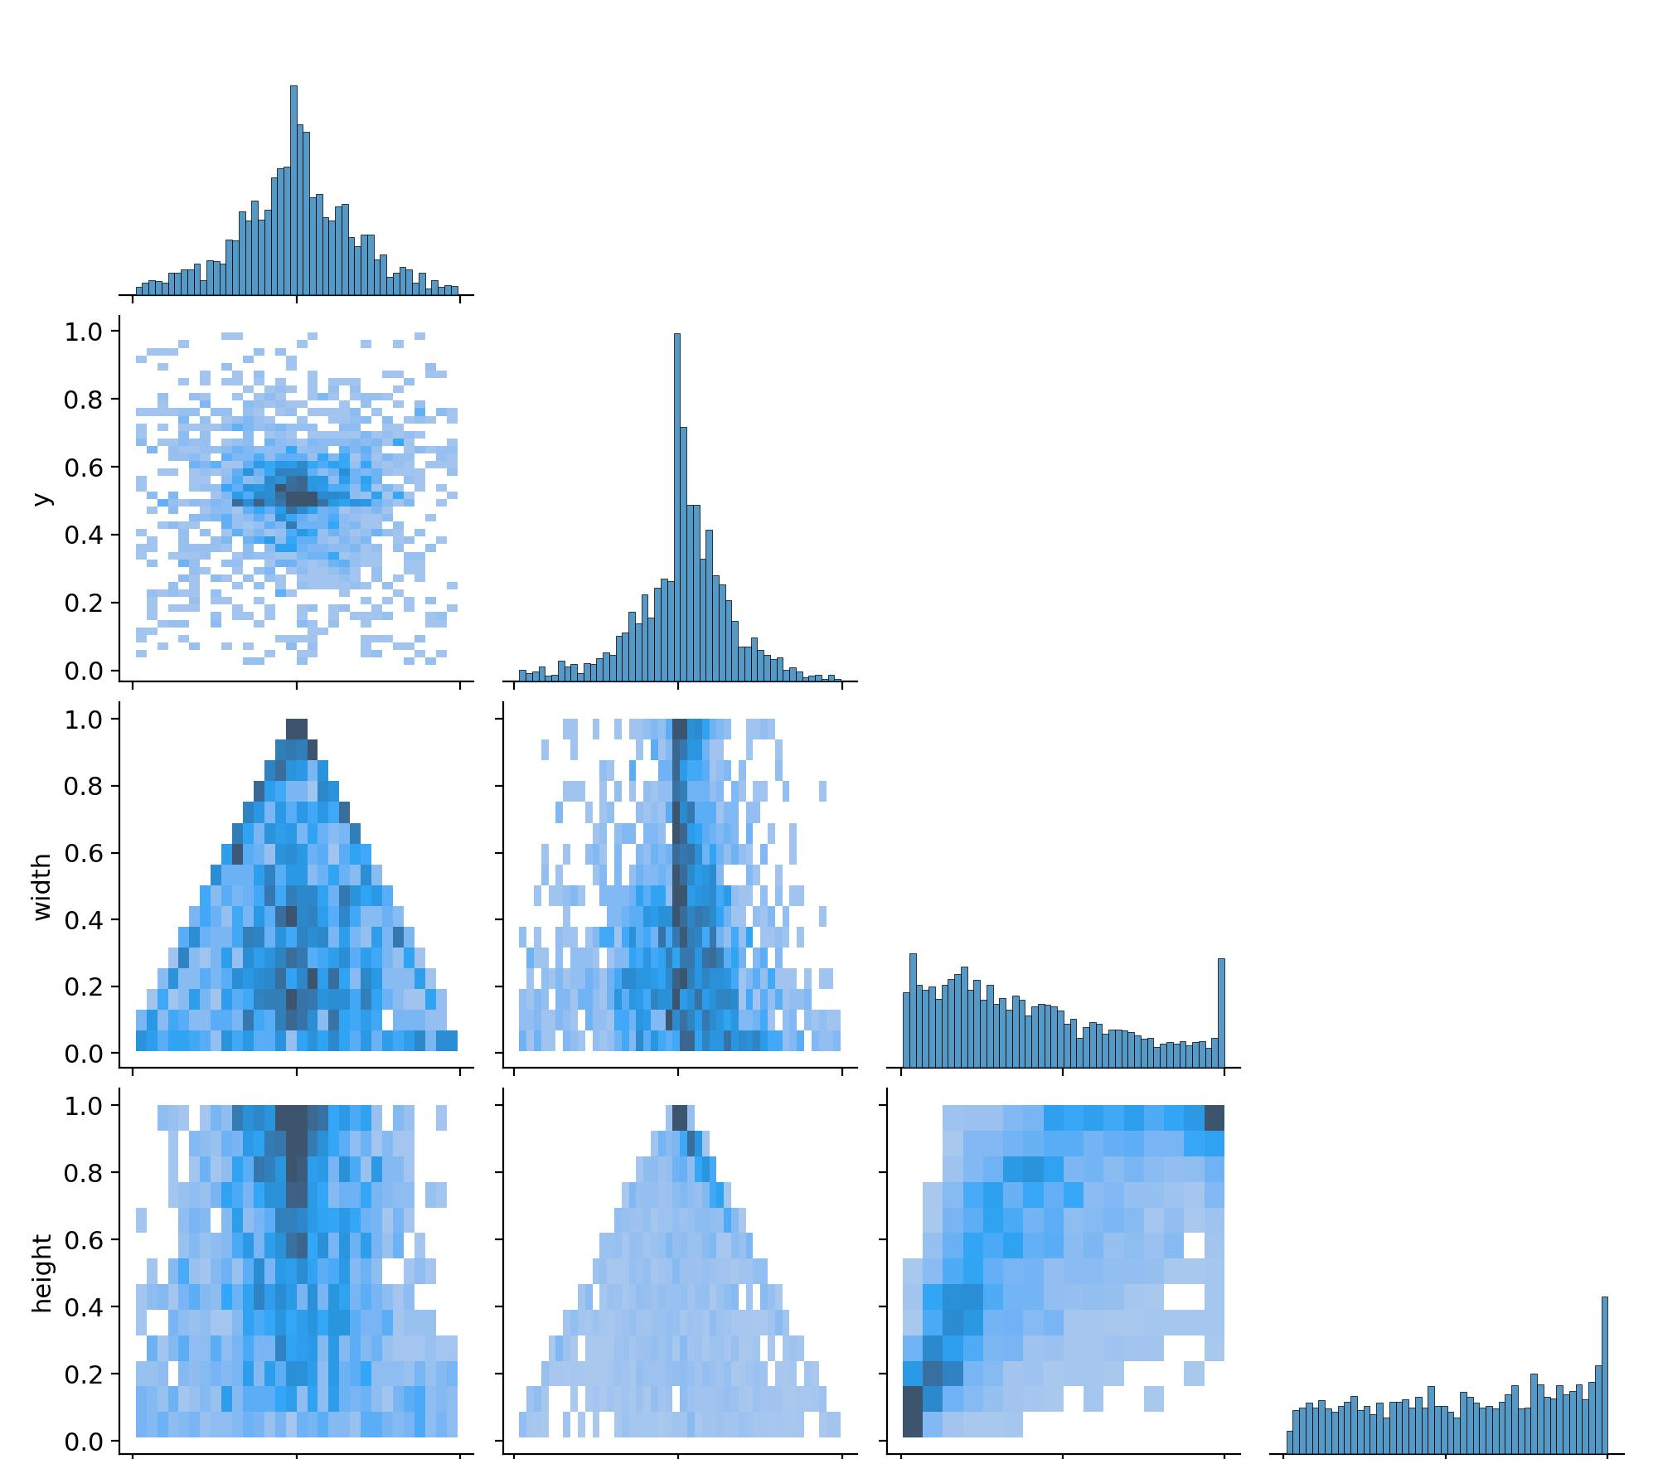
Performance Evaluation
Precision and Recall Metrics:
Top-left: Precision (B) graph
Top-right: Recall (B) graph
Mean Average Precision (mAP):
Bottom-left: mAP50 (B) graph
Bottom-right: mAP50-95 (B) graph
Label Distribution and Correlation:
Top histograms: Distribution of x, y, width, height
Scatter plots: Correlation among x, y, width, height

Slide 11
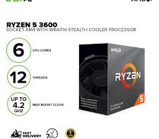
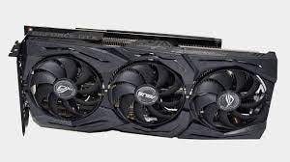
Operating System & Software Versions
AMD Ryzen 3600 processor, Nvidia GTX 1660 Super GPU.
Maximum thermal envelope (TDP): 65W.
Library and Software Versions:
Python 3.12 and 3.8 (for cv2).
Libraries: Ultralytics YOLOv8, CvZone, PyTorch, TensorFlow.
Development Tools: PyCharm (Python), Unity 3D 2024, Microsoft Visual Studio Community (C#).

Slide 12
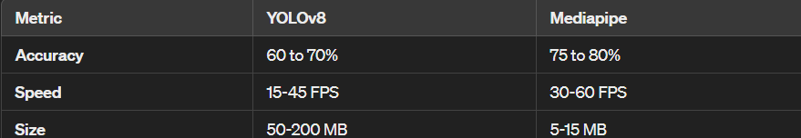
Model Comparison
YOLO V8 Vs Mediapipe

Slide 13
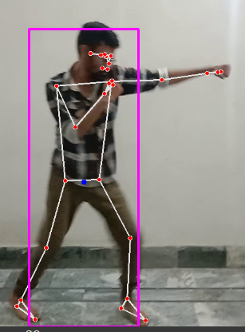
Conclusion
This research presents a novel approach for virtual character animation using YOLOv8 and MediaPipe.
Fine-tuned YOLOv8 model demonstrates promising results in real-time pose detection.
Integration with Unity 3D enables automatic motion replication for interactive applications.
Applications in VR, gaming, and motion capture.
Contribution to advancing computer vision and virtual character animation.

Slide 14
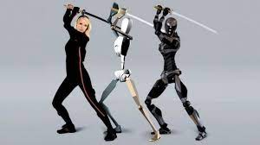
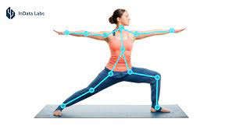
Future Work /Application
Enhance model accuracy and performance.
Expand dataset for diverse poses.
Applications in interactive storytelling, immersive content creation, VR experiences, and gaming.

Slide 15
References:
[1] Davies, T., Taylor, J., & Morten, T. (2017). "Markerless motion capture using multiple color cameras." IEEE Transactions on Circuits and Systems for Video Technology, 27(4), 783-797.
[2] Cao, Z., Simon, T., Wei, S. E., & Sheikh, Y. (2017). "Realtime multi-person 2D pose estimation using part affinity fields." CVPR.
[3] Lee, Y., Liu, M. Y., & Grauman, K. (2019). "MoCoGAN: Decomposing motion and content for video generation." CVPR.
[4] Holden, D., Saito, J., & Komura, T. (2017). "Deep learning of human character motion." ACM Transactions on Graphics (TOG), 36(4), 1-16.
[5] Magnenat-Thalmann, N., & Thalmann, D. (2004). "The Making of Virtual Humans." Springer Science & Business Media.
[6] Loper, M., Mahmood, N., & Black, M. J. (2014). "MoSh: Motion and shape capture from sparse markers." ACM Transactions on Graphics (TOG), 33(6), 1-14.

